Slide 1
Week 2
Alexey V. Zimin
JHU BME 580.417/707

Slide 2
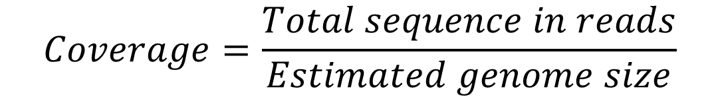
Coverage
Coverage refers to redundancy in sequencing data
Commonly expressed as <number>x, such as 20x, 30x, etc.
For paired reads one can compute coverage by reads and coverage by fragments
$$Coverage=\frac{Total sequence in reads}{Estimated genome size}$$
fragment or insert
read
AGATAGACATAGACATAGACAGATACACTCGATCG TCTATCTGTATCTGTATCTGTCTATGTGAGCTAGC
read

Slide 3
How much coverage is sufficient?
It depends… on read lengths
1x is enough if read length == chromosome length
In general read length << chromosome length
Problem: assume fixed read length << chromosome length
What is the probability of a gap?
Use Poisson distribution!

Slide 4
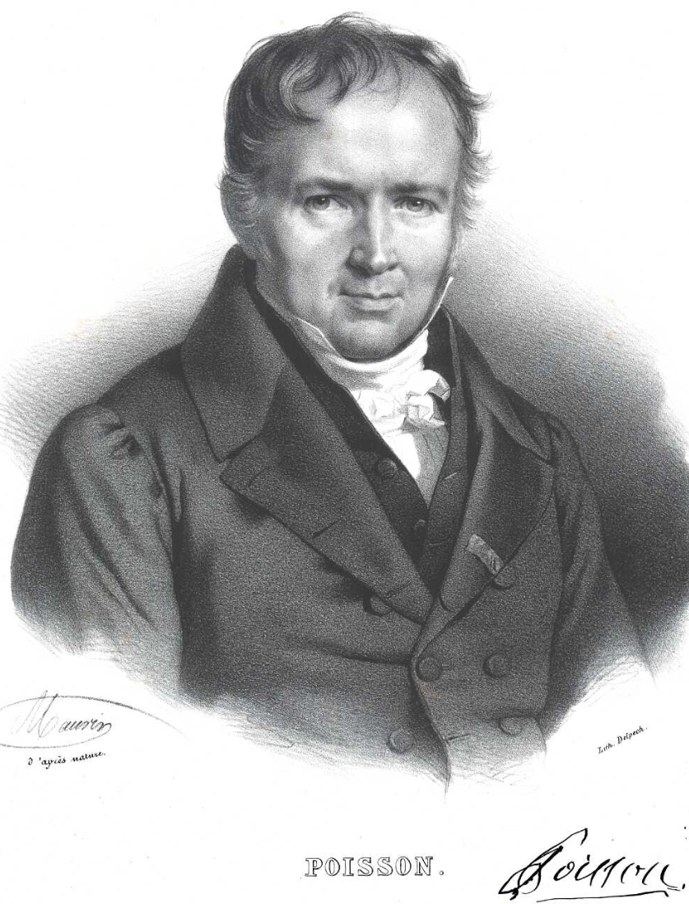
Poisson distribution
The Poisson distribution is a discrete probability distribution that expresses the probability of a given number of events occurring in a fixed interval of time if these events occur with a known constant mean rate and independently of the time since the last event.
Named after French mathematician Siméon Denis Poisson (1781–1840). Image credit:Wikipedia

Slide 5
Example of a Poisson process
For instance, consider a call center which receives an average of λ = 3 calls per minute at all times of day.
If the number of calls received in any two given disjoint time intervals is independent, then the number k of calls received during any minute has a Poisson probability distribution.
Can you come up with an example?

Slide 6
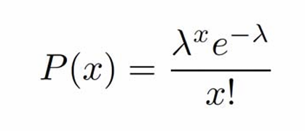
Poisson distribution
The Poisson distribution is also the limit of a binomial distribution, for which the probability of success for each trial p equals λ/n, as the number of trials n approaches infinity
Under a Poisson distribution with the expectation of λ events in a given interval, the probability of x events in the same interval is:

Slide 7
Poisson distribution and coverage
Let:
G genome length (in bp)
L read average length (L<<G)
N number of reads
Then:
λ, sequencing redundancy = N*L/G
x is the number of reads covering a given site on the genome
For a given base on the genome for each read Prob(base covered)=L/G << 1; number of attempts (reads): N >> 1.
Genome coverage λ = NL/G is O(1). x=2 x=4 x=0

Slide 8
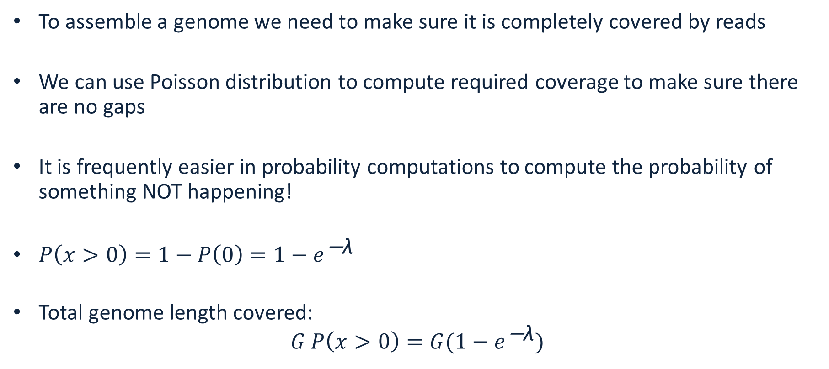
Fraction of the genome covered
To assemble a genome we need to make sure it is completely covered by reads
We can use Poisson distribution to compute required coverage to make sure there are no gaps
It is frequently easier in probability computations to compute the probability of something NOT happening!
${P\left(x>0\right)=1−P\left(0\right)=1−e}^{\text{−}\text{λ}}$
Total genome length covered: ${G P\left(x>0\right)=G(1−e}^{\text{−}\text{λ}})$

Slide 9
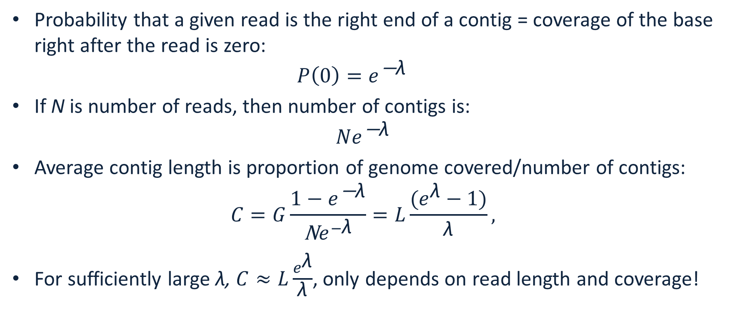
Number of contigs and average length
Probability that a given read is the right end of a contig = coverage of the base right after the read is zero: ${P\left(0\right)=e}^{\text{−}\text{λ}}$
If N is number of reads, then number of contigs is: ${Ne}^{\text{−}\text{λ}}$
Average contig length is proportion of genome covered/number of contigs: $C=G\frac{{1−e}^{\text{−}\text{λ}}}{\text{N}e^{−\text{λ}}}=L\frac{(e^{\text{λ}}−1)}{\text{λ}},$
For sufficiently large λ, $C≈L\frac{e^{\text{λ}}}{\text{λ}}$, only depends on read length and coverage!

Slide 10
Genome is fully covered. Can this be assembled?
1 bp overlap
0 bp overlap
1 bp overlap

Slide 11
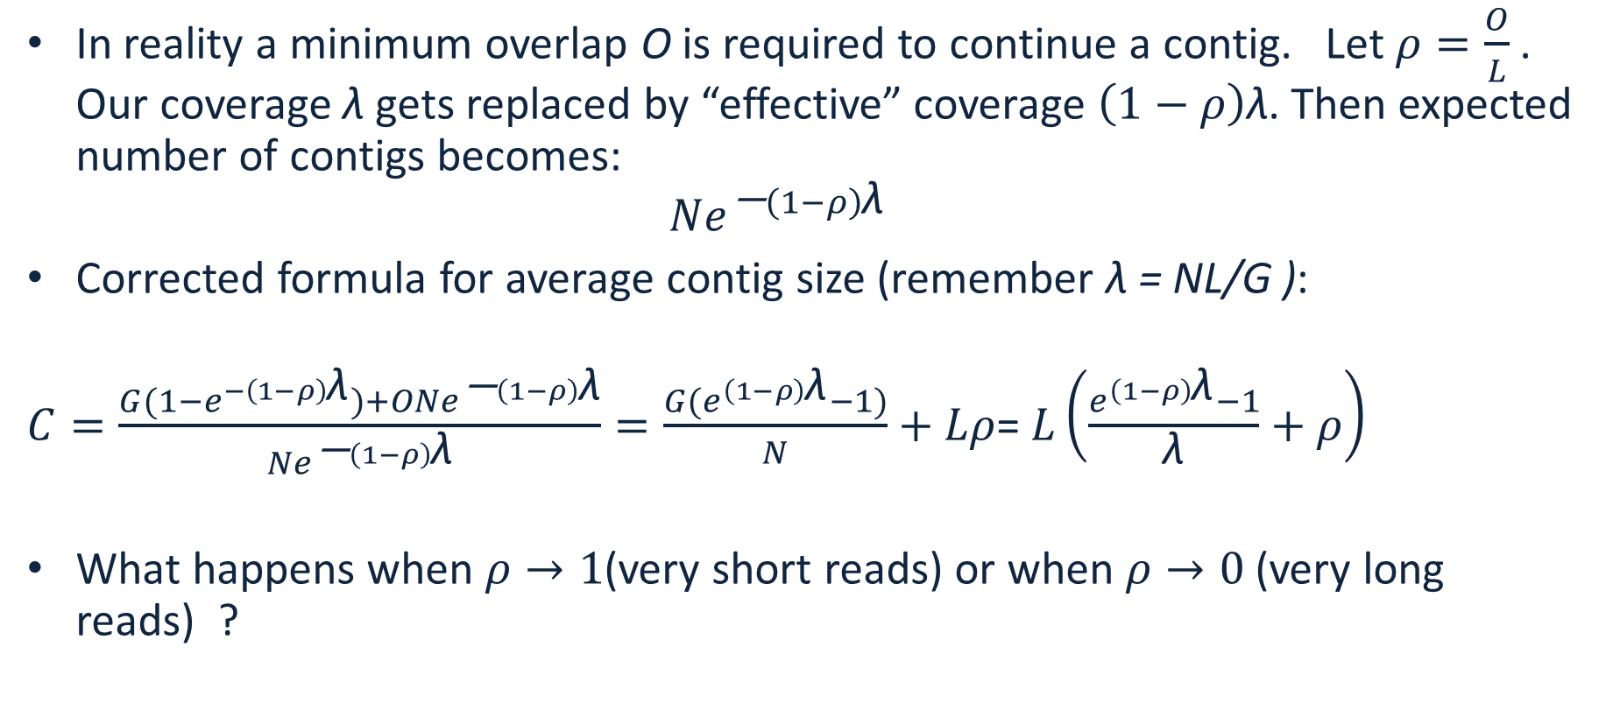
Real life correction to contig length
In reality a minimum overlap O is required to continue a contig. Let $ρ=\frac{O}{L}$. Our coverage $\text{λ}$gets replaced by “effective” coverage $\left(1−ρ\right)\text{λ}$. Then expected number of contigs becomes: ${Ne}^{\text{−}\left(1−ρ\right)\text{λ}}$
Corrected formula for average contig size (remember λ = NL/G ):
$C=\frac{{G(1−e}^{−\left(1−ρ\right)\text{λ}})+O{Ne}^{\text{−}\left(1−ρ\right)\text{λ}}}{{Ne}^{\text{−}\left(1−ρ\right)\text{λ}}}=\frac{{G(e}^{\left(1−ρ\right)\text{λ}}−1)}{N}+Lρ$= $L\left(\frac{e^{\left(1−ρ\right)\text{λ}}−1}{\text{λ}}+ρ\right)$
What happens when $ρ→1$(very short reads) or when $ρ→0$ (very long reads) ?

Slide 12
Reads are Strings
String S is a finite sequence of characters from an alphabet
DNA alphabet is {A,C,G,T}
Substring of S is a string occurring inside S: AGTGACATAAGACT
Prefix of S is a string starting at the beginning of S: AGTGACATAAGACT
Suffix of a string is a string ending at the end of S: AGTGACATAAGACT

Slide 13
Exact matching
Find exact matches of two strings: T: ATGATATGACATAGAC and P: ATGAC
Naïve: check every position: T:ATGATATGACATAGAC P:ATGAC
Boyer-Moore bad character rule, skip pointless alignments:
consider the character in T at which the comparison process failed (assuming such a failure occurred).
Find the next occurrence of that character to the left in P
Propose a shift which brings that occurrence in line with the mismatched occurrence in T.
If the mismatched character does not occur to the left in P, a shift is proposed that moves the entirety of P past the point of mismatch.

Slide 14
Exact matching
Boyer-Moore bad character rule, skip pointless alignments: T:ATGATATGACATAGAC P:ATGAC check last character – if no match skip to the first occurrence, aligning the T T:ATGATATGACATAGAC P:ATGAC P:ATGAC P:ATGAC P:ATGAC P:ATGAC P:ATGAC P:ATGAC

Slide 15
What is an alignment (overlap)?
An alignment does not need to be an exact match
Given:
– a pair of strings
– a method for scoring a candidate alignment
Do:
– determine the correspondences between substrings in the sequences such that the similarity score is maximized

Slide 16
Example of an alignment (overlap)
Alignment of two DNA sequences
AGCGAACGCTGAACGCTAGACCG
and
GCGATCGATGAAGCTAGACTCGT
is
AGCGAACGCTGAACGCTAGAC-CG
|||| || ||||*|||||||*|| GCGATCGATGAA-GCTAGACTCGT

Slide 17
Types of mis-matches
Substitutions: AAGT vs ATGT
Deletions: AAGT vs ATT
Insertions: AAGT vs AAGCT

Slide 18
Smith-Waterman alignment
Published by M.S Waterman; T.F Smith; W.A Beyer (1976)
Local sequence alignment
Fairly expensive: for sequences of lengths m and n is of order O(mn)
Dynamic programming: solve many local problems to then solve the big problem

Slide 19
Smith-Waterman alignment
Align sequences: TGTTACGG and GGTTGACTA
Choose match score s(a,b)=3 if a=b, s(a,b)=-3 if a!=b
Choose gap penalty G=2
Initialize top row and the first column with zeros
 |  | T | G | T | T | A | C | G | G
 | 0 | 0 | 0 | 0 | 0 | 0 | 0 | 0 | 0
G | 0
G | 0
T | 0
T | 0
G | 0
A | 0
C | 0
T | 0
A | 0

Slide 20
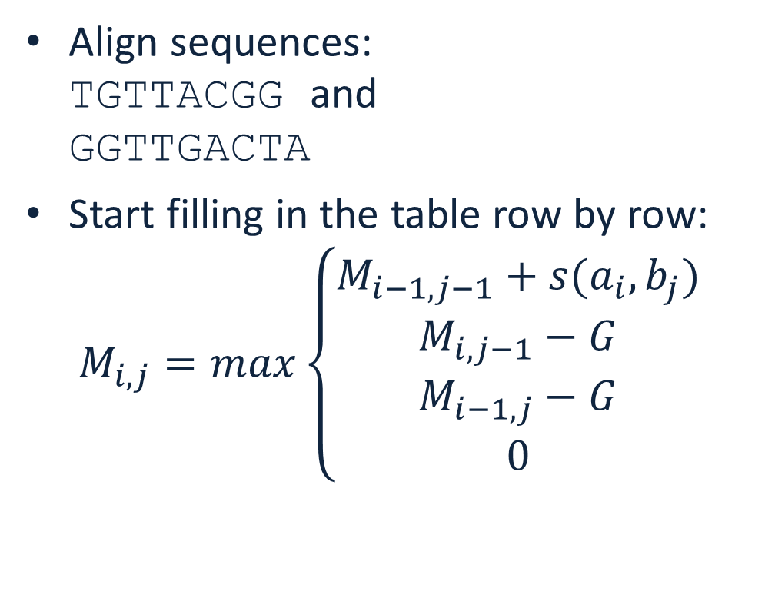
Smith-Waterman alignment
Align sequences: TGTTACGG and GGTTGACTA
Start filling in the table row by row: $M_{i,j}=max\left\{\begin{matrix}M_{i−1,j−1}+s(a_{i},b_{j}) \\ M_{i,j−1}−G \\ \begin{matrix}M_{i−1,j}−G \\ 0\end{matrix}\end{matrix}\right.$
 |  | T | G | T | T | A | C | G | G
 | 0 | 0 | 0 | 0 | 0 | 0 | 0 | 0 | 0
G | 0
G | 0
T | 0
T | 0
G | 0
A | 0
C | 0
T | 0
A | 0

Slide 21
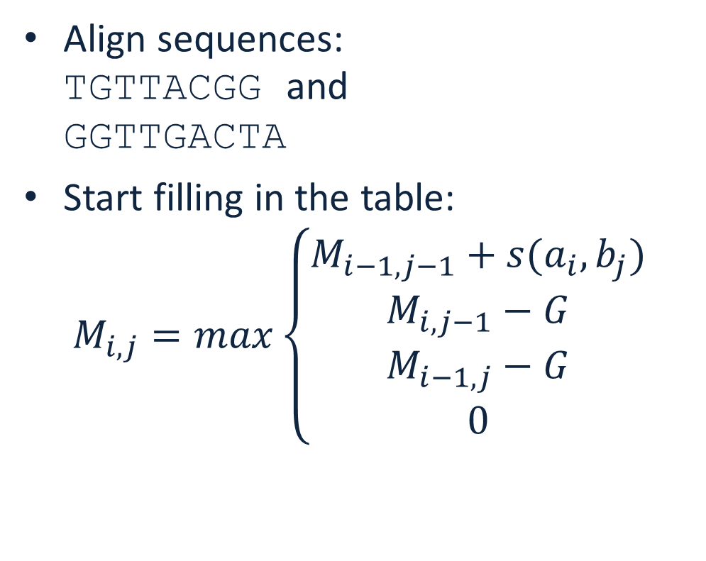
Smith-Waterman alignment
Align sequences: TGTTACGG and GGTTGACTA
Start filling in the table: $M_{i,j}=max\left\{\begin{matrix}M_{i−1,j−1}+s(a_{i},b_{j}) \\ M_{i,j−1}−G \\ \begin{matrix}M_{i−1,j}−G \\ 0\end{matrix}\end{matrix}\right.$
 |  | T | G | T | T | A | C | G | G
 | 0 | 0 | 0 | 0 | 0 | 0 | 0 | 0 | 0
G | 0 | 0 | 3 | 1 | 0 | 0 | 0 | 3 | 3
G | 0
T | 0
T | 0
G | 0
A | 0
C | 0
T | 0
A | 0

Slide 22
Smith-Waterman alignment
Align sequences: TGTTACGG and GGTTGACTA
Start filling in the table: $M_{i,j}=max\left\{\begin{matrix}M_{i−1,j−1}+s(a_{i},b_{j}) \\ M_{i,j−1}−G \\ \begin{matrix}M_{i−1,j}−G \\ 0\end{matrix}\end{matrix}\right.$
 |  | T | G | T | T | A | C | G | G
 | 0 | 0 | 0 | 0 | 0 | 0 | 0 | 0 | 0
G | 0 | 0 | 3 | 1 | 0 | 0 | 0 | 3 | 3
G | 0 | 0 | 3 | 1 | 0 | 0 | 0 | 3 | 6
T | 0
T | 0
G | 0
A | 0
C | 0
T | 0
A | 0

Slide 23
Smith-Waterman alignment
Align sequences: TGTTACGG and GGTTGACTA
Start filling in the table: $M_{i,j}=max\left\{\begin{matrix}M_{i−1,j−1}+s(a_{i},b_{j}) \\ M_{i,j−1}−G \\ \begin{matrix}M_{i−1,j}−G \\ 0\end{matrix}\end{matrix}\right.$
 |  | T | G | T | T | A | C | G | G
 | 0 | 0 | 0 | 0 | 0 | 0 | 0 | 0 | 0
G | 0 | 0 | 3 | 1 | 0 | 0 | 0 | 3 | 3
G | 0 | 0 | 3 | 1 | 0 | 0 | 0 | 3 | 6
T | 0 | 3 | 1 | 6 | 4 | 2 | 0 | 1 | 4
T | 0
G | 0
A | 0
C | 0
T | 0
A | 0

Slide 24
Smith-Waterman alignment
Align sequences: TGTTACGG and GGTTGACTA
Start filling in the table: $M_{i,j}=max\left\{\begin{matrix}M_{i−1,j−1}+s(a_{i},b_{j}) \\ M_{i,j−1}−G \\ \begin{matrix}M_{i−1,j}−G \\ 0\end{matrix}\end{matrix}\right.$
 |  | T | G | T | T | A | C | G | G
 | 0 | 0 | 0 | 0 | 0 | 0 | 0 | 0 | 0
G | 0 | 0 | 3 | 1 | 0 | 0 | 0 | 3 | 3
G | 0 | 0 | 3 | 1 | 0 | 0 | 0 | 3 | 6
T | 0 | 3 | 1 | 6 | 4 | 2 | 0 | 1 | 4
T | 0 | 3 | 1 | 4 | 9 | 7 | 5 | 3 | 2
G | 0 | 1 | 6 | 4 | 7 | 6 | 4 | 8 | 6
A | 0 | 0 | 4 | 3 | 5 | 10 | 8 | 6 | 5
C | 0 | 0 | 2 | 1 | 3 | 8 | 13 | 11 | 9
T | 0 | 3 | 1 | 5 | 4 | 6 | 11 | 10 | 8
A | 0 | 1 | 0 | 3 | 2 | 7 | 9 | 8 | 7

Slide 25
Smith-Waterman alignment
Align sequences: TGTTACGG and GGTTGACTA
Pick the cell with the highest score
Traceback exploring all return paths of the same score
at every step choose the highest score
stop at 0
 |  | T | G | T | T | A | C | G | G
 | 0 | 0 | 0 | 0 | 0 | 0 | 0 | 0 | 0
G | 0 | 0 | 3 | 1 | 0 | 0 | 0 | 3 | 3
G | 0 | 0 | 3 | 1 | 0 | 0 | 0 | 3 | 6
T | 0 | 3 | 1 | 6 | 4 | 2 | 0 | 1 | 4
T | 0 | 3 | 1 | 4 | 9 | 7 | 5 | 3 | 2
G | 0 | 1 | 6 | 4 | 7 | 6 | 4 | 8 | 6
A | 0 | 0 | 4 | 3 | 5 | 10 | 8 | 6 | 5
C | 0 | 0 | 2 | 1 | 3 | 8 | 13 | 11 | 9
T | 0 | 3 | 1 | 5 | 4 | 6 | 11 | 10 | 8
A | 0 | 1 | 0 | 3 | 2 | 7 | 9 | 8 | 7

Slide 26
Smith-Waterman alignment
Align sequences: TGTTACGG and GGTTGACTA
Alignment result: TGTT-ACGG ||| || GGTTGACTA
 |  | T | G | T | T | A | C | G | G
 | 0 | 0 | 0 | 0 | 0 | 0 | 0 | 0 | 0
G | 0 | 0 | 3 | 1 | 0 | 0 | 0 | 3 | 3
G | 0 | 0 | 3 | 1 | 0 | 0 | 0 | 3 | 6
T | 0 | 3 | 1 | 6 | 4 | 2 | 0 | 1 | 4
T | 0 | 3 | 1 | 4 | 9 | 7 | 5 | 3 | 2
G | 0 | 1 | 6 | 4 | 7 | 6 | 4 | 8 | 6
A | 0 | 0 | 4 | 3 | 5 | 10 | 8 | 6 | 5
C | 0 | 0 | 2 | 1 | 3 | 8 | 13 | 11 | 9
T | 0 | 3 | 1 | 5 | 4 | 6 | 11 | 10 | 8
A | 0 | 1 | 0 | 3 | 2 | 7 | 9 | 8 | 7

